Slide 1
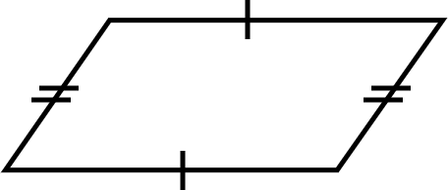
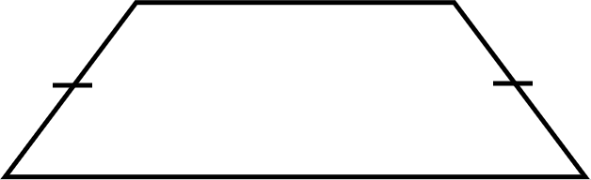
Problem solving with perimeter and area
Task A: Using one to find the other
1) Calculate the area.
2) Calculate the perimeter.
4 units
6 units
5 units
6 units
13 units
The perimeter of this shape is 31 units.
The area of this shape is 63 units².
Task B: Perimeter and area in context
1) Alex’s garden is an unusual shape. He wants to put a fence around it. What is the total length of fencing he needs to buy?
4 m
10 m
7 m

Slide 2
Problem solving with perimeter and area
2) a) Jun is a painter. They want to create a mural. How much space will the mural take up?
b) The rectangular wall Jun plans to paint on measures 21 cm by 38 cm. Will the mural fit on the wall? Justify your answer.
26 cm
21 cm
38 cm
50 cm
Task C: Units of measurement
1) Andeep’s sister wants to tile a wall in her bathroom. The wall is rectangular and measures 3 m by 4.5 m.
Each tile is a square which measures 50 cm by 50 cm.
How many tiles will she need to use to cover the wall?
Mathematics in Education and Industry.

